Slide 1
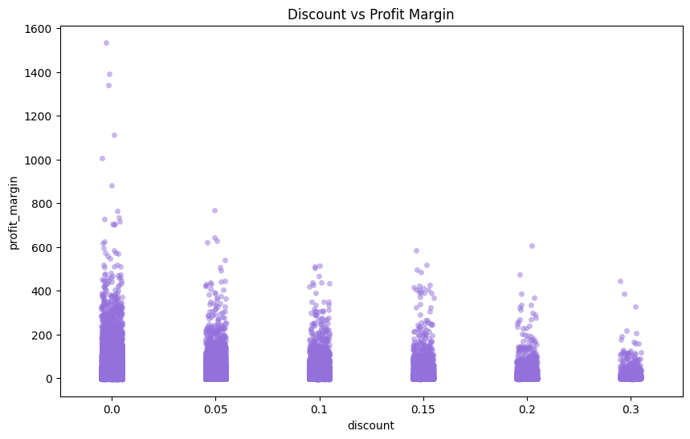
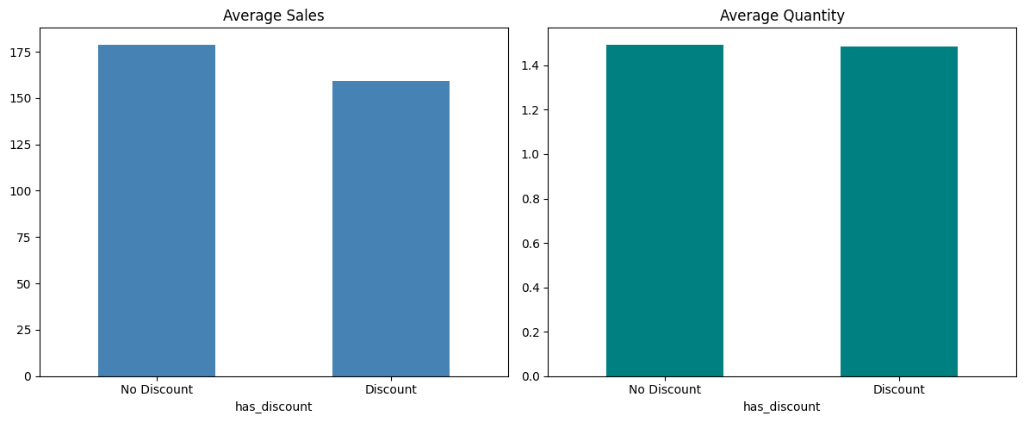
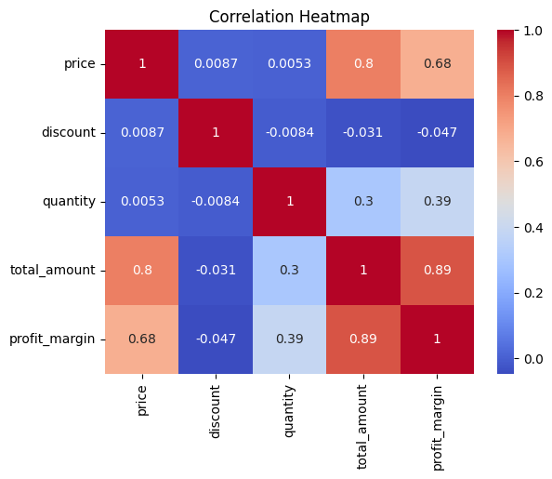
Do Discounts Actually Drive Sales?
EGYPT UNIVERSITY OF INFORMATICS
Computer & Information Systems
Data Analysis · Project III · 2025
A data-driven study of 34,500 e-commerce transactions on the impact of discount strategy on revenue and profitability
Habiba Hefnawy · Ahmed Tarek · Hana Aladdin · Mohamed Tamer · Mohamed Ziad
MAIN FINDING
Discounts don’t lift sales — and may, instead, reduce profitability.
Welch’s t-test (n = 34,500) shows discounted orders generate an equal to slightly lower average sales amount than full-price orders (t = −5.22, p < 0.0001).
1
Background & Hypotheses
HYPOTHESES
RESEARCH QUESTION
H₀ No significant difference in sales between discounted and non-discounted products.
How do discounts affect e-commerce sales and customer purchasing behavior, and to what extent do they impact profitability?
H₁ Discounts have a statistically significant positive impact on e-commerce sales.
2
Method & Data
34,500
18
~ 2 yrs
0 – 30 %
transactions
features
of activity
discount range
Welch’s independent-samples t-test compares two independent groups (discounted vs. non-discounted) at α = 0.05. Equal variances are not assumed; the very large sample size makes the test valid despite skewed sales distributions, by the Central Limit Theorem.
3
Key Findings
FIGURE 1 · Profit Margin by Discount Tier
FIGURE 2 · Average Sales & Average Quantity by Discount Status
FIGURE 2 · Average Sales & Quantity — Discount vs. No Discount
→ A clear downward drift in profit margin as discount depth grows from 0 % to 30 %.
→ Non-discounted orders deliver higher average sales with an almost identical quantity sold.
−5.22
< 0.0001
Reject H₀
t-statistic
p-value
@ α = 0.05
4
Why It Holds
FIGURE 3 · Correlation between key variables
Discount’s correlation with every key business metric is near zero or slightly negative.
r = −0.031
vs. Total Sales
r = −0.047
vs. Profit Margin
5
What It Means
The data overturn the common intuition that lower prices drive higher sales. The null hypothesis is rejected, but in the opposite direction of what is usually assumed: discounted transactions perform slightly worse than full-price ones, and deeper discounts erode margin without growing volume.
FOR THE EGYPTIAN E-COMMERCE MARKET
In a price-sensitive market where promotions are a default tactic, blanket discounting risks shrinking margin without growing volume. Sustainable growth is more likely to come from product value, customer experience and brand — not simply the depth of a discount.

